Slide 1
TFFR Investment Update
For the Periods Ended June 30, 2018
September 19, 2018
Note: This document contains unaudited data which is deemed to be
materially accurate, but is unaudited and subject to change.
Dave Hunter, Executive Director/CIO
Darren Schulz, Deputy Chief Investment Officer
Connie Flanagan, Fiscal and Investment Operations Manager
ND Retirement & Investment Office (RIO)
State Investment Board (SIB)

Slide 2
TFFR Investment Ends – June 30, 2018
SIB clients should receive investment returns consistent with their written investment policies and market variables. This “End” is evaluated based on comparison of each client’s (a) actual net investment return, (b) standard deviation and (c) risk adjusted excess return, to the client’s policy benchmark over 5 years.
TFFR earned $211 million of net income in fiscal 2018 (and nearly $850 million in fiscal 2014 to 2018).
Key Point: TFFR investments have averaged nearly $2.2 billion during the last 5-years and Excess Return has averaged over 0.50% per annum. Based on these values, TFFR’s use of active management has enhanced Net Investment Returns by $55 million for the 5-years ended June 30, 2018 (or $2.2 billion x 0.50% = $11 million x 5 years = $55 million). This Excess Return has been achieved while adhering to prescribed Risk limits (e.g. 108% versus a policy limit of 115%).
Current Policy Benchmark: 58% Equity (31% U.S., 21% Non-U.S., 6% Private); 23% Fixed Income (16% U.S., 7% High Yield); 18% Real Assets (10% Real Estate; 5.7% Infrastructure; 2.3% Timber); and 1% Cash.

Slide 3
TFFR’s Actual Asset Allocations are within 2.5% of Target noting that the Private Equity Underweight of 2.5% is offset by Overweight allocations to Domestic Equity of 1.7% and International Equity of 0.9%.

Slide 4
U.S. Small Caps (Russell 2000) and U.S. Large Cap (S&P 500) returned over 17% and 14%, respectively, followed by Emerging Market Equities (MSCI EM) at 8.6% and International Equity (MSCI EAFE) a5 6.8%, while U.S. Fixed Income (Blmbg. Aggregate) declined 0.4% in Fiscal 2018.

Slide 5
Executive Summary for periods ended June 30, 2018
Investment Performance Update –
TFFR earned a net investment return of 9.1% in fiscal 2018 versus a policy benchmark of less than 8%. The financial markets remained resilient last year noting that TFFR U.S. Equity portfolio earned 16.4% in fiscal 2018 (versus 15.3% for the benchmark) and TFFR International Equity strategies were up 10.1% last year (versus a 7.3% benchmark). Private Equity returns continued to underperform, but more recent investments have showed marked improvement versus pre-2013 investments. TFFR fixed income returns also exceeded expectations with Investment Grade posting a 1.60% gain (versus -0.40% for the bench-mark) while High Yield earned 5.2% in fiscal 2018 (versus a 2.6% benchmark). Real Assets results were mixed with Real Estate and Infrastructure earning 7.7 and 7.4% last year, respectively, (both slightly above benchmarks), while Timber declined 2.5% (versus a +3.6% benchmark).
Asset allocation is the primary driver of returns noting that TFFR target allocation is 58% Equity, 23% Fixed Income, 18% Real Assets and 1% Cash. TFFR earned a net return of 8.3% for the 5-years ended June 30, 2018, which exceeded the performance benchmark of 7.5% (and long-term actuarial assumption of 7.75%). During the last 5-years, TFFR earned nearly $850 million of net investment income including $795 million (or 94%) from asset allocation decisions and $55 million1 (or 6%) from the prudent use of active management.
TFFR investment returns were ranked in the 26th percentile for the 5-years ended June 30, 2018 (and 2017), based on Callan’s Public Fund Sponsor Database (on an unadjusted risk basis).
Changes in Asset Class Portfolio Structures and Tactical Approaches –
During the last year, the SIB approved structural changes to eliminate agency MBS and international debt strategies. These changes are expected to improve risk adjusted returns within the Pension Trust largely due to the elimination of international fixed income with low expected returns and high expected volatility. In order to implement these changes, TFFR’s asset allocation within Fixed Income was revised to reduce Investment Grade to 16% (from 19%) while increasing Non-Investment Grade to 7% (from 4%). The total allocation to Fixed Income will remain constant at 23%.
Footnote 1: Assuming TFFR assets averaged $2.2 billion for the 5-years ended June 30, 2018 ($2.2 billion x 0.50% = $11 million x 5 years = $55 million).

Slide 8
Comparison of Major Asset Class Returns vs. Benchmark
Global Equities earned 12.38% for the 1-year ended June 30, 2018, which was 1.25% above the benchmark, while the 5-year return of 10.05 surpassed the benchmark of 9.38% by 0.67%.
Global Fixed Income earned 3.58% last year and 4.14% the last 5-years due to strong returns in U.S. Fixed Income including high yield & private credit offset by weaker returns in International Debt and Long Term Treasuries due to rising rates.
Global Real Assets earned 6.06% last year and 7.94% the last 5-years with Real Estate and Infrastructure surpassing benchmarks while Timber trailed its benchmark by over 6%.
Every major asset class outperformed their respective benchmarks for the 1 and 5-years ended June 30, 2018, with strong returns in all asset classes other than Private Equity and Timber.

Slide 9
TFFR’s “gross” returns were ranked in the 26th percentile for the 5-years ended June 30, 2018, based on Callan’s “Public Fund Sponsor Database”.
Unadjusted Ranking
Note: TFFR’s asset allocation adjusted ranking was in the 3rd percentile for the 5-years ended June 30, 2018.

Slide 10
NOTE: SIB utilizes the private markets to invest in real estate, infrastructure and timber (in addition to private equity and private debt).

Slide 11
TFFR Activity from June 30, 2017 to June 30, 2018
Net Investment Position improved by $170 million (f) as Pension Benefit Payments exceeded Pension Contributions by $39 million (b), while Net Investment Earnings were $211 million (c) after investment expenses (of approximately $12 million).
Note: The above table is unaudited and subject to change, but deemed to be materially accurate.

Slide 12
Note: All amounts are deemed to be materially accurate, but are unaudited and subject to change.

Slide 13
Global Equity, Fixed Income and Real Asset Valuations

Slide 14
TFFR Net Returns for Periods Ended
June 30, 2018
TFFR earned 9.1% for the fiscal year ended June 30, 2018, beating the Policy Target Benchmark Return of 7.9%.
TFFR’s U.S. Equities were the top performer with a 16.4% return in FY 2018 followed by Global and International Equities at 12.3% and 10.1%, respectively in fiscal 2018.

Slide 15
TFFR Net Returns for Periods Ended
June 30, 2018
Private Equity returns are disappointing in recent years although post-2012 investments with Adams Street Partners (in their 2016, 2016 and 2017 Global Funds) have been encouraging and the BlackRock PEP program should start to generate more consistently positive returns within the next two years, if not in Fiscal 2019.

Slide 16
TFFR Net Returns for Periods Ended
June 30, 2018
Global Fixed Income earned 3.58% in fiscal 2018, exceeding the 2.00% benchmark. Strong returns in Private Credit strategies with PIMCO and Declaration more than offset disappointing returns with Loomis Sayles in public high yield and long-term U.S. Treasuries during the last fiscal year.

Slide 17
TFFR Net Returns for Periods Ended
June 30, 2018
Global Real Assets earned over 6% in Fiscal 2018 with Real Estate and Infra-structure earning 7.7% and 7.3%, respectively, while Timber valuations declined 2.5% last year. Global Real Assets have generate above benchmark returns of nearly 8% for the 5-years ended June 30, 2018, largely due to 10% target allocation to Real Estate with JPMorgan and Invesco.

Slide 18
TFFR assets exceed $2.5 billion as of June 30, 2018, while net investment income exceeds $211 million.

Slide 19
TFFR Investment Policy Statement Annual Review

Slide 20
TFFR Investment Policy Statement Review – Sep.27, 2018
1. PLAN CHARACTERISTICS AND FUND CONSTRAINTS.
The North Dakota Teachers’ Fund for Retirement (TFFR) is a pension benefit plan that was established in 1913 to provide retirement income to all public school and certain state teachers and administrators in the state of North Dakota. The plan is administered by a seven member Board of Trustees comprised of five active and retired members of the fund appointed by the Governor of North Dakota and two elected officials - the State Treasurer and the State Superintendent of Public Instruction.
The plan is a multi-employer defined benefit public pension plan that provides retirement, disability, and death benefits in accordance with Chapter 15-39.1 of the North Dakota Century Code (NDCC). Monthly retirement benefits are based on the formula: Number of Years of service X 2.0% X Final Average Salary. Adjustments to the basic formula are made depending on the retirement option selected.
Funding is provided by monthly employee and employer contributions scheduled to increase as follows:
7/1/11 7/1/12 7/1/14
Employee 7.75% 9.75% 11.75%
Employer 8.75% 10.75% 12.75%
Employee and employer contributions will be reduced to 7.75% each when TFFR reaches 100% funded level on an actuarial value basis.
The TFFR Board has an actuarial valuation performed annually and an Experience Study and Asset Liability Study performed every five years. The actuarial assumed rate of return on assets was reduced to 7.75% from 8.0% as of July 1, 2015. Key plan and financial statistics are recorded in the most recent valuation report on file at the North Dakota Retirement and Investment office (RIO).
2. FUND GOALS
The Plan benefits are financed through both statutory employer and employee contributions and the investment earnings on assets held in the Fund. The TFFR Board recognizes that a sound investment program is essential to meet the pension obligations.
As a result, the Fund goals are to:
Improve the Plan’s funding status to protect and sustain current and future benefits.
Minimize the employee and employer contributions needed to fund the Plan over the long term.
Avoid substantial volatility in required contribution rates and fluctuations in the Plan’s funding status.
Accumulate a funding surplus to provide increases in retiree annuity payments to preserve the purchasing power of their retirement benefit.
The Board acknowledges the material impact that funding the pension plan has on the State/School District’s financial performance. These goals affect the Fund ’s investment strategies and of ten represent conflicting goals. For example, minimizing the long-term funding costs implies a less conservative investment program, whereas dampening the volatility of contributions and avoiding large swings in the funding status implies a more conservative investment program. The Board places a greater emphasis on the strategy of improving the funding status and reducing the contributions that must be made to the Fund, as it is most consistent with the long-term goal of conserving money to apply to other important state/local projects.

Slide 21
TFFR Investment Policy Statement Review - Sep. 27, 2018
RESPONSIBILITIES AND DISCRETION OF THE STATE INVESTMENT BOARD (SIB).
The TFFR Board is charged by law under NDCC 21-10-02.1 with the responsibility of establishing policies on investment goals and asset allocation of the Fund. The SIB is charged with implementing these policies and investing the assets of the Fund in the manner provided in NDCC 21-10-07, the prudent investor rule. Under this rule, the fiduciaries shall exercise the judgment and care, under the circumstances then prevailing, that an institutional investor of ordinary prudence, discretion, and intelligence exercises in the management of large investments entrusted to it, not in regard to speculation but in regard to the permanent disposition of funds, considering probable safety of capital as well as probable income. The Fund must be invested exclusively for the benefit of the members and their beneficiaries in accordance with this investment policy.
Management responsibility for the investment program not assigned to the SIB in Chapter 21-10 of the North Dakota Century Code (NDCC) is hereby delegated to the SIB, who must establish written policies for the operation of the investment program, consistent with this investment policy.
The SIB may delegate investment responsibility to professional money managers. Where a money manager has been retained, the SIB’s role in determining investment strategy and security selection is supervisory, not advisory.
At the discretion of the SIB, the Fund’s assets may be pooled with other funds. In pooling funds, the SIB may establish whatever asset class pools it deems necessary with specific quality, diversification, restrictions, and performance objectives appropriate to the prudent investor rule and the objectives of the funds participating in the pools.
The SIB is responsible for establishing criteria, procedures, and making decisions with respect to hiring, keeping, and terminating money managers. SIB investment responsibility also includes selecting performance measurement services, consultants, report formats, and frequency of meetings with managers.
The SIB will implement changes to this policy as promptly as is prudent.
4. RISK TOLERANCE
The Board is unwilling to undertake investment strategies that might jeopardize the ability of the Fund to finance the pension benefits promised to plan participants.
However, funding the pension promise in an economical manner is critical to the State/School Districts ability to continue to provide pension benefits to plan participants. Thus, the Board actively seeks to lower the cost of funding the Plan’s pension obligations by taking on risk for which it expects to be compensated over the long term. The Board understands that a prudent investment approach to risk taking can result in periods of under-performance for the Fund in which the funding status may decline. These periods, in turn, can lead to higher required contribution rates. Nevertheless, the Board believes that such an approach, prudently implemented, best serves the long-run interests of the State/School District and, therefore, of plan participants.
5. INVESTMENT OBJECTIVES
The Board’s investment objectives are expressed in terms of reward and risk expectations relative to investable, passive benchmarks. The Fund’s policy benchmark is comprised of policy mix weights of appropriate asset class benchmarks as set by the SIB
1) The fund’s rate of return, net of fees and expenses, should at least match that of the policy benchmark over a minimum evaluation period of five years.
2) The fund’s risk, measured by the standard deviation of net returns, should not exceed 115% of the policy benchmark over a minimum evaluation period of five years.
3) The risk adjusted performance of the fund, net of fees and expenses, should at least match that of the policy benchmark over a minimum evaluation period of five years.

Slide 22
TFFR Investment Policy Statement Review – Sep.27, 2018
6. POLICY ASSET MIX
Benefit payments are projected to occur over a long period of time. This allows TFFR to adopt a long-term investment horizon and asset allocation policy for the management of fund assets. Asset allocation policy is critical because it defines the basic risk and return characteristics of the investment portfolio. Asset allocation targets are established using an asset-liability analysis designed to assist the Board in determining an acceptable volatility target for the fund and an optimal asset allocation policy mix. This asset-liability analysis considers both sides of the plan balance sheet, utilizing both quantitative and qualitative inputs, in order to estimate the potential impact of various asset class mixes on key measures of total plan risk, including the resulting estimated impact of funded status and contribution rates. After consideration of all the inputs and a discussion of its own collective risk tolerance, the Board approves the appropriate policy asset mix for the Fund.
Note: Last year, TFFR approved RIO’s recommendation to reduce Investment Grade Debt to 16% (from 19%) and increase Non-Investment Grade to 7% (from 4%) while eliminating International Debt (of 6%) to improve expected risk adjusted returns (by eliminating low yielding Non-U.S. debt with high volatility).

Slide 23
TFFR Investment Policy Statement Review – Sep.27, 2018
An allocation to Global Alternatives of up to 10% is authorized but shall not increase the expected volatility of the portfolio as measured in Section 5; and if utilized, all other targets will be adjusted pro-rata. The Board does not endorse tactical asset allocation, therefore, it is anticipated the portfolio be managed as close to the policy target as is prudent and practicable while minimizing rebalancing costs. Rebalancing of the Fund to this target will be done in accordance with the SIB’s rebalancing policy.
7. RESTRICTIONS
While the SIB is responsible for establishing specific quality, diversification, restrictions, and performance objectives for the investment vehicles in which the Fund’s assets will be invested, it is understood that:
Futures and options may be used to hedge or replicate underlying index exposure, but not for speculation.
Derivative use will be monitored to ensure that undue risks are not taken by the money managers
No transaction shall be made which threatens the tax exempt status of the Fund.
All assets will be held in custody by the SIB’s master custodian or such other custodians as are acceptable to the SIB.
No unhedged short sales or speculative margin purchases shall be made.
Social investing is prohibited unless it meets the Exclusive Benefit Rule and it can be substantiated that the investment must provide an equivalent or superior rate of return for a similar investment with a similar time horizon and similar risk.
For the purpose of this document, Social Investing is defined as “The investment or commitment of public pension
fund money for the purpose of obtaining an effect other than a maximized return to the intended beneficiaries.”
g. Economically targeted investing is prohibited unless the investment meets the Exclusive Benefit Rule.
For the purpose of this document economically targeted investment is defined as an investment designed to produce
a competitive rate of return commensurate with risk involved, as well as to create collateral economic benefits for a
targeted geographic area, group of people, or sector of the economy.
Also, for the purpose of this document, the Exclusive Benefit Rule is met if the following four conditions are satisfied:
1) The cost does not exceed the fair market value at the time of investment.
2) The investment provides the Fund with an equivalent or superior rate of return for a similar investment with a similar time horizon and similar task.
3) Sufficient liquidity is maintained in the Fund to permit distributions in accordance with the terms of the plan.
4) The safeguards and diversity that a prudent investor would adhere to are present.
Where investment characteristics, including yield, risk, and liquidity are equivalent, the Board’s policy favors investments which will have a positive impact on the economy of North Dakota.

Slide 24
TFFR Investment Policy Statement Review – Sep.27, 2018
8. INTERNAL CONTROLS
A system of internal controls must be in place by the SIB to prevent losses of public funds arising from fraud or employee error. Such controls deemed most important are the separation of responsibilities for investment purchases from the recording of investment activity, custodial safekeeping, written confirmation of investment transactions, and established criteria for broker relationships. The annual financial audit must include a comprehensive review of the portfolio, accounting procedures for security transactions and compliance with the investment policy.
9. EVALUATION AND REVIEW
Investment management of the Fund will be evaluated against the Fund’s investment objectives. Emphasis will be placed on five year results. Evaluation should include an assessment of the continued feasibility of achieving the investment objectives and the appropriateness of the Investment Policy Statement for achieving those objectives.
Performance reports will be provided to the TFFR Board periodically, but not less than annually. Such reports will include asset returns and allocation data as well as information regarding all significant and/or material matters and changes pertaining to the investment of the Fund, including but not limited to:
A list of the advisory services managing investments for the board.
A list of investments at market value, compared to previous reporting period, of each fund managed by each advisory service.
Earnings, percentage earned, and change in market value of each fund’s investments.
Comparison of the performance of each fund managed by each advisory service to other funds under the board’s control and to generally accepted market indicators.
All material legal or legislative proceedings affecting the SIB.
Compliance with this investment policy statement.
TFFR Board Adopted: May 25, 1995.
Amended: November 30, 1995; August 21, 1997; July 15, 1999; July 27, 2000; September 18, 2003; July 14, 2005; September 21, 2006; September 20, 2007; October 27, 2011; September 26, 2013; January 21, 2016; September 21, 2017, January 25, 2018
Approved by SIB: November 18, 2011, February 26, 2016, September 22, 2017, January 26, 2018
ND Teachers’ Fund For Retirement ND State Investment Board
Date:___________________________ Date:____________________________

Slide 25
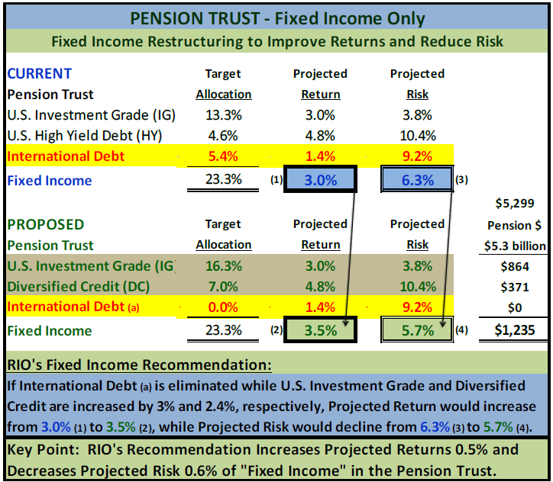

Slide 26
2018 Capital Market Projections – Return and Risk
Summary of Callan’s Long-Term Capital Market Projections (2018 – 2027)
 |  | PROJECTED RETURN |  |  |  | PROJECTED RISK
Asset Class | Index | 1-Year Arithmetic | 10-Year Geometric* | Real |  | Standard Deviation | Sharpe Ratio | Projected Yield
Equities
Broad Domestic Equity | Russell 3000 | 8.30% | 6.85% | 4.60% |  | 18.25% | 0.332 | 2.00%
Large Cap | S&P 500 | 8.05% | 6.75% | 4.50% |  | 17.40% | 0.333 | 2.10%
Small/Mid Cap | Russell 2500 | 9.30% | 7.00% | 4.75% |  | 22.60% | 0.312 | 1.55%
Global ex-U.S. Equity | MSCI ACWI ex USA | 8.95% | 7.00% | 4.75% |  | 21.00% | 0.319 | 3.10%
International Equity | MSCI World ex USA | 8.45% | 6.75% | 4.50% |  | 19.70% | 0.315 | 3.25%
Emerging Markets Equity | MSCI Emerging Markets | 10.50% | 7.00% | 4.75% |  | 27.45% | 0.301 | 2.65%
Fixed Income
Short Duration | Barclays G/C 1-3 | 2.60% | 2.60% | 0.35% |  | 2.10% | 0.167 | 2.85%
Domestic Fixed | Barclays Aggregate | 3.05% | 3.00% | 0.75% |  | 3.75% | 0.213 | 3.50%
Long Duration | Barclays Long G/C | 3.50% | 3.00% | 0.95% |  | 10.95% | 0.116 | 4.45%
TIPS | Barclays TIPS | 3.10% | 3.00% | 0.75% |  | 5.25% | 0.162 | 3.35%
High Yield | Barclays High Yield | 5.20% | 4.75% | 2.50% |  | 10.35% | 0.285 | 7.75%
Non-U.S. Fixed | Barclays Global Aggregate ex US | 1.80% | 1.40% | -0.85% |  | 9.20% | -0.049 | 2.50%
Emerging Market Debt | EMBI Global Diversified | 4.85% | 4.50% | 2.25% |  | 9.60% | 0.271 | 5.75%
Other
Real Estate | Callan Real Estate | 6.90% | 5.75% | 3.50% |  | 16.35% | 0.284 | 4.75%
Private Equity | TR Post Venture Cap | 12.45% | 7.35% | 5.10% |  | 32.90% | 0.310 | 0.00%
Hedge Funds | Callan Hedge FOF Database | 5.35% | 5.05% | 2.80% |  | 9.15% | 0.339 | 2.25%
Commodities | Bloomberg Commodity | 4.25% | 2.65% | 0.40% |  | 18.30% | 0.109 | 2.25%
Cash Equivalents | 90-Day T-Bill | 2.25% | 2.25% | 0.00% |  | 0.90% | 0.000 | 2.25%
Inflation | CPI-U |  | 2.25% |  |  | 1.50%
* Geometric returns are derived from arithmetic returns and the associated risk (standard deviation).
Source: Callan LLC

Slide 27
Economic & Capital Markets Update

Slide 28
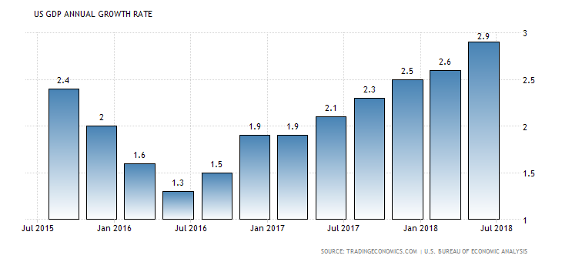
U.S. Economy – Annual GDP Growth Rates
US GDP Growth Rates:
The US economy expanded at an annual growth rate of 2.9% in the 2nd quarter of 2018 increasing from 2.6% for the 1st quarter of 2018 and up from 2.1% in the 2nd quarter of 2017. The United States is the world’s largest economy. Yet, in the last two decades, like in the case of many other developed nations, U.S. growth rates have generally been declining. GDP annual growth rates in the U.S. averaged 3.2% from 1948 until 2017, reaching an all-time high of 13.4% in the 4th quarter of 1950 and a record low of -3.9% in the 2nd quarter of 2009. Last updated in July of 2018.

Slide 29
Global GDP Growth Rate - History & Forecast
Global GDP Growth Rates have increased from:
  3% in 2012-to-2016 to
  3.2% in 2017 and 2018, but expected
  to decline back to 3% in 2019 to 2022.
Global GDP Growth in the Emerging Markets is expected to trend downward over the next decade largely due to China’s growth rate slowing from:
  5.3% in 2012-to-2016 down to
  4% in 2018 and sub-4% thereafter.
Key Take-Away: World GDP growth rates continue to show meaningfully positive trends albeit at slower rates.

Slide 30
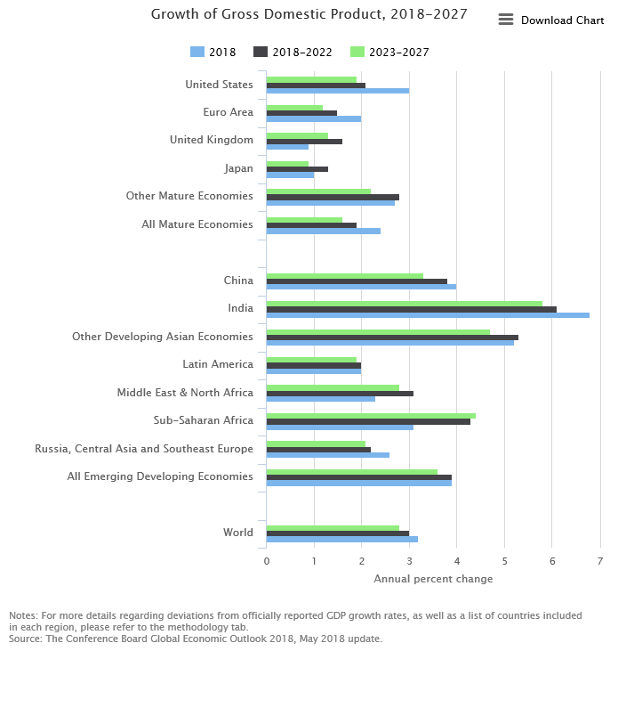

Slide 31
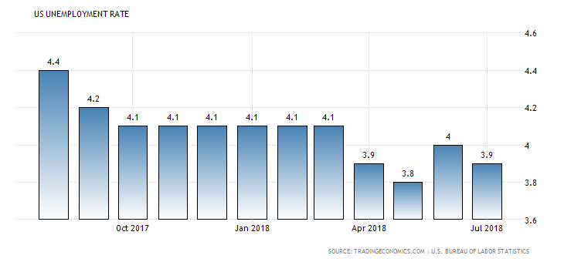
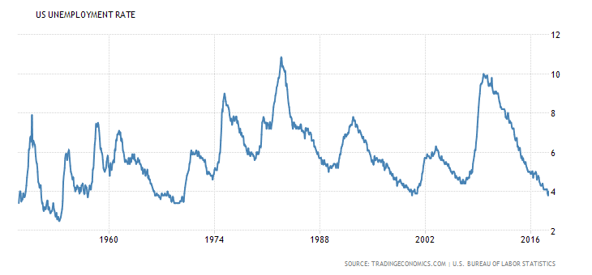
U.S. Unemployment Rates
The US unemployment fell to 3.9% in July of 2018 matching market expectations (versus 4.0% in June). The jobless rate touched an 18-year low of 3.8% in May (the lowest since April 2000).
In July, the number of unemployed persons declined by 284,000 to 6.3 million (versus 7 million slightly over a year ago).
2017 to 2018
1950 to 2018

Slide 35

The S
S&P 500 Index:
+21.8% in 2017
S&P 500 Index:
+2.65% 1st Half 2018

Slide 36
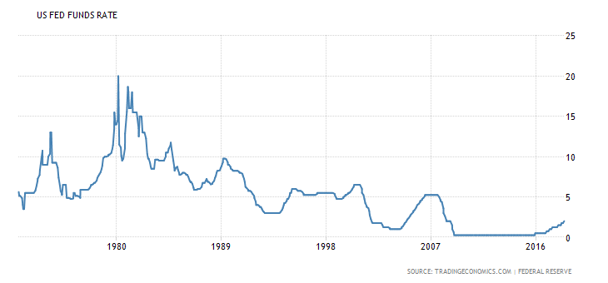
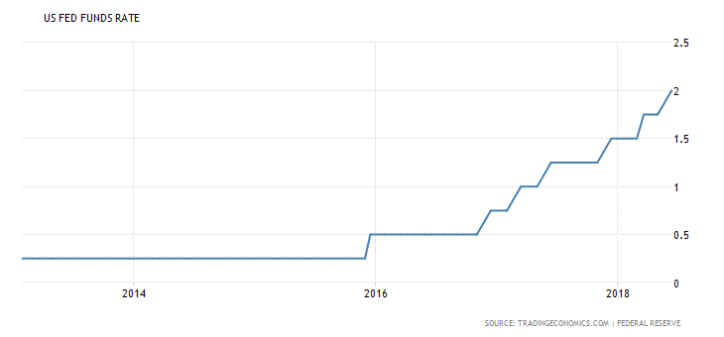
U.S. Fed Funds Rate (1971 to 2018)
Background: The federal funds rate is the interest rate at which banks lend reserve balances to other banks overnight (on an uncollateralized basis). Banks with surplus balances lend to those in need of larger balances. Reserve balances are held at the Federal Reserve to maintain the banks’ reserve requirements. Changes in the federal funds rate trigger a chain of events that affect other short-term interest rates, foreign exchange rates, long-term interest rates, the amount of money and credit, and, ultimately, a range of economic variables, including employment, output, and prices of goods and services. The Federal Reserve uses "monetary policy" to influence the availability and cost of money and credit to help promote national economic goals.
The Fed Funds target rate was increased 0.25% in December of 2015 and 2016 and March, June and December of 2017 and March and June of 2018 (to 2%).
The Federal Reserve has raised the target range for federal funds five (5) times in the past 18 months including three rate hikes in 2017 and two rate hikes in the first of 2018. Interest Rates in the United States averaged 5.79 percent from 1971 until 2017, reaching an all time high of 20 percent in March of 1980 and a record low of 0.25 percent in December of 2008.

Slide 37
UST Yield Curve 12/31/13 vs 6/30/17:

Slide 38
Appendix of Supporting Materials
TFFR Update as of June 30, 2018
Callan’s Quarterly Reports of investment performance are available on the following web address:
http://www.nd.gov/rio/SIB/Publications/Callan%20Quarterly%20reports/Invest%20Quarterly.htm
Board members can review monthly manager level performance using the following web address:
http://www.nd.gov/rio/rio_ref/
The SIB has no investment managers on our Watch List as of June 30, 2018, and there are no material legal or legislative proceedings affecting the SIB, although RIO has submitted three optional packages for budget approval.
Option 1 – Reinstate 10%; Option 2 – TFFR Pension Modernization; Option 3 – New Investment Risk Officer (+1 FTE).

Slide 39
RIO Budget Background
On April 18, 2018, Governor Burgum released budget guidelines for 2019-2021. The Governor is requesting all agencies (including special fund agencies) to adopt the following guidelines:
Agencies with an appropriation less than $5 million should submit a base budget with a 5% reduction in ongoing expenditures;
Agencies with an appropriation of $5 million or more should submit a base budget with a 10% reduction in ongoing expenditures; and
Agencies with 20 or more FTE should submit a base budget with a 5% FTE reduction.
RIO currently has 19 authorized FTE and our appropriation for 2017-19 is $5.3 million. Given that RIO’s budget is over $5 million, we were requested to submit a base budget which included a 10% reduction which translates into less FTE in the summary table below. The FTE reduction is assumed due to RIO’s budget largely consisting of salaries and benefits (for $4.4 million or 83%) while operating expenses and contingencies have already been reduced to historically low levels. As evidence, RIO’s operating expenses declined by 13% over the past 20 years (to less than $863,000 in 2017-19) due to our agency consistently being very cost conscious. RIO’s contingency line has also been subject to extreme budget pressures and was reduced by over 36% in the last biennium (to $52,000).
RIO management believes our agency has operated in a fiscally conservative manner for many years, while maintaining favorable client satisfaction survey scores (for both TFFR and SIB) despite a 38% increase in TFFR membership (from 15,781 in 1998 to 21,853 in 2017) and 80% increase in assets under management (AUM) since 2013. During the last 20-years, RIO’s FTE has only grown by 1 person including two new investment professionals in the last 6-years (which coincided with an 90+% increase in AUM between 2013 and 2018). RIO’s overall performance has generally been strong as evidenced by solid client survey scores while investment performance has generally met or exceeded expectations in recent years including above benchmark returns, favorable peer rankings, and a keen focus on optimizing risk adjusted returns. SIB clients have benefitted from an excellent return on their investment over the last 5-years as evidenced by a 2-for-1 return on investment fees which conservatively translates into over $300 million of incremental client investment income since 2014.

Slide 40
RIO Budget Submission – Agency Overview
Column A: RIO’s 2017-19 Approved Budget was for $5.3 million (including 19 FTE).
Column B: RIO’s Base Budget submission of $4.8 million reflects a 10% cut in agency expenses as OMB requested.
Column C: Option 1 - Given RIO’s desire to maintain high quality service levels while noting that SIB investments and TFFR’s client population are at all-time highs, RIO respectfully seeks to reinstate the 10% OMB budget cut request .
Column D: Option 2 – Given TFFR’s pension administration system is 13-years old and our desire to adopt recent IT system advances, efficiencies and cybersecurity protection levels, we respectfully made a 1-time request for $9.1 million.
Column E: Option 3 – RIO also requests $309,446 to enhance our investment risk management team, controls and processes by adding a new investment risk officer position to further improve our overall risk management environment.
Column F: RIO’s Total Budget Request for 2019-21 including three (3) optional packages exceeds $14.8 million.
RIO’s Budget submission is classified at the SIB and TFFR board level on the following page.

Slide 41
RIO Budget Submission – July 20, 2018
TFFR and SIB Component Overview
Optional Package # 2 is a one-time request. Optional Package # 3 does not materially impact internal investment management costs (e.g. 0.001%).

